Slide 1



DAY CARE
GROUP - 4
ANJALI KAKADE (002923023)
NETRA AWATE (001529534)
RAKESH BADDI (001443182)
SHUBHAM PATIL (002928545)
VATSAL KAPADIA (002747692
YASH FIRKE (002928176)
sdffdsdfsfv

Slide 2

OUR DAY CARE
Our project works on managing daycare where you enroll students and assign teachers based on the age groups and also define the class strength on the same basis. We can also manage the enrollments of the students and have an overview of each student's vaccination status

Slide 3
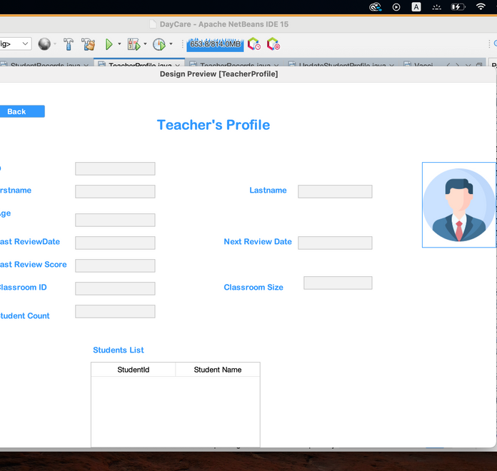


DESIGN POINTS
01
02
Notable and easy to access GUI. Smoot navigation and transitions to different frames.
CSV used to make the database for each person and further subcategories
03
JAVA SE used. We have used JDK 19 for the implementation of the program

Slide 4
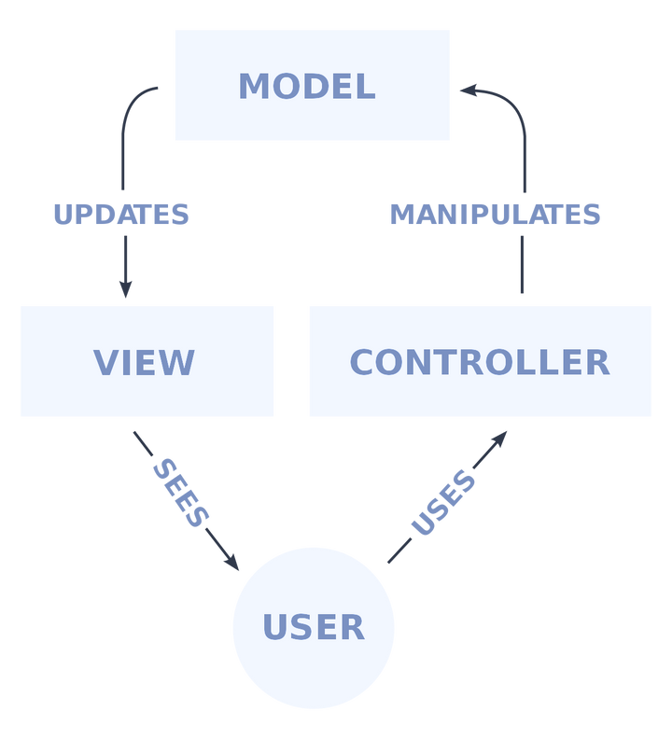
DESIGN FLOW POINTS
MODELS
The database's backend, which has all the data logic
VIEW
CONTROLLER
The graphical user interface or frontend (GUI)
The software's central processing unit that manages how data is displayed

Slide 5
MODELS
Daycare Model
Instructor Model
01
02
Contains List of all important features like classrooms, students, teachers, ratio rule etc.
It contains all the vital information about the instructor including complete name, class ID, Salary, tracks for reviews and assigned students
Student Model
Ratio Rule Model
03
04
It contains all the vital information about the student including complete name, parents details, class ID, teachers details, tracks for Registration renewals
Contains information about the group size, class size etc.
Vaccination Model
Classroom Model
05
06
Contains information about the vaccines, due dates, students' records corresponding to each vaccine, and tracing their dates for vac
Saves information about a class like its ID, size, the teacher assigned, age group.

Slide 6
FACTORY DESIGN PATTERN MODELS
Abstract Factory Model
01
Abstract Interface to define set of methods for creating objects
Classroom Eager Singleton Factory
02
Implementation for classroom lazy singleton factory that is extended from the abstract factory
Student Eager Singleton Factory
03
Implementation for student lazy singleton factory that is extended from the abstract factory . To create student objects, we utilize a StudentEagerSingletonFactory class and define the getObject method.

Slide 7
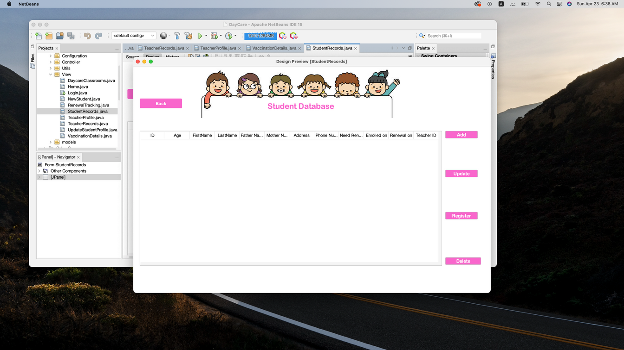
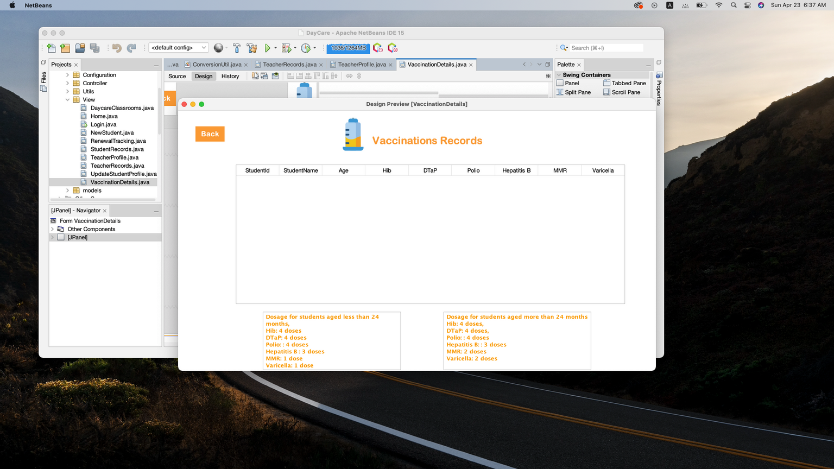
VIEWS
Login
Home
New Student
Student Records
Student Profile Update
Teacher Profile
Teacher Records
Daycare Classrooms
Vaccination Details
Renewal Tracking

Slide 8
CONTROLLER
01
Login Controller
02
Student Main Controller
03
New Student Controller
04
Student Details Controller
05
Vaccination Controller
06
Renewal Tracking Controller
07
Classroom Controller

Slide 9
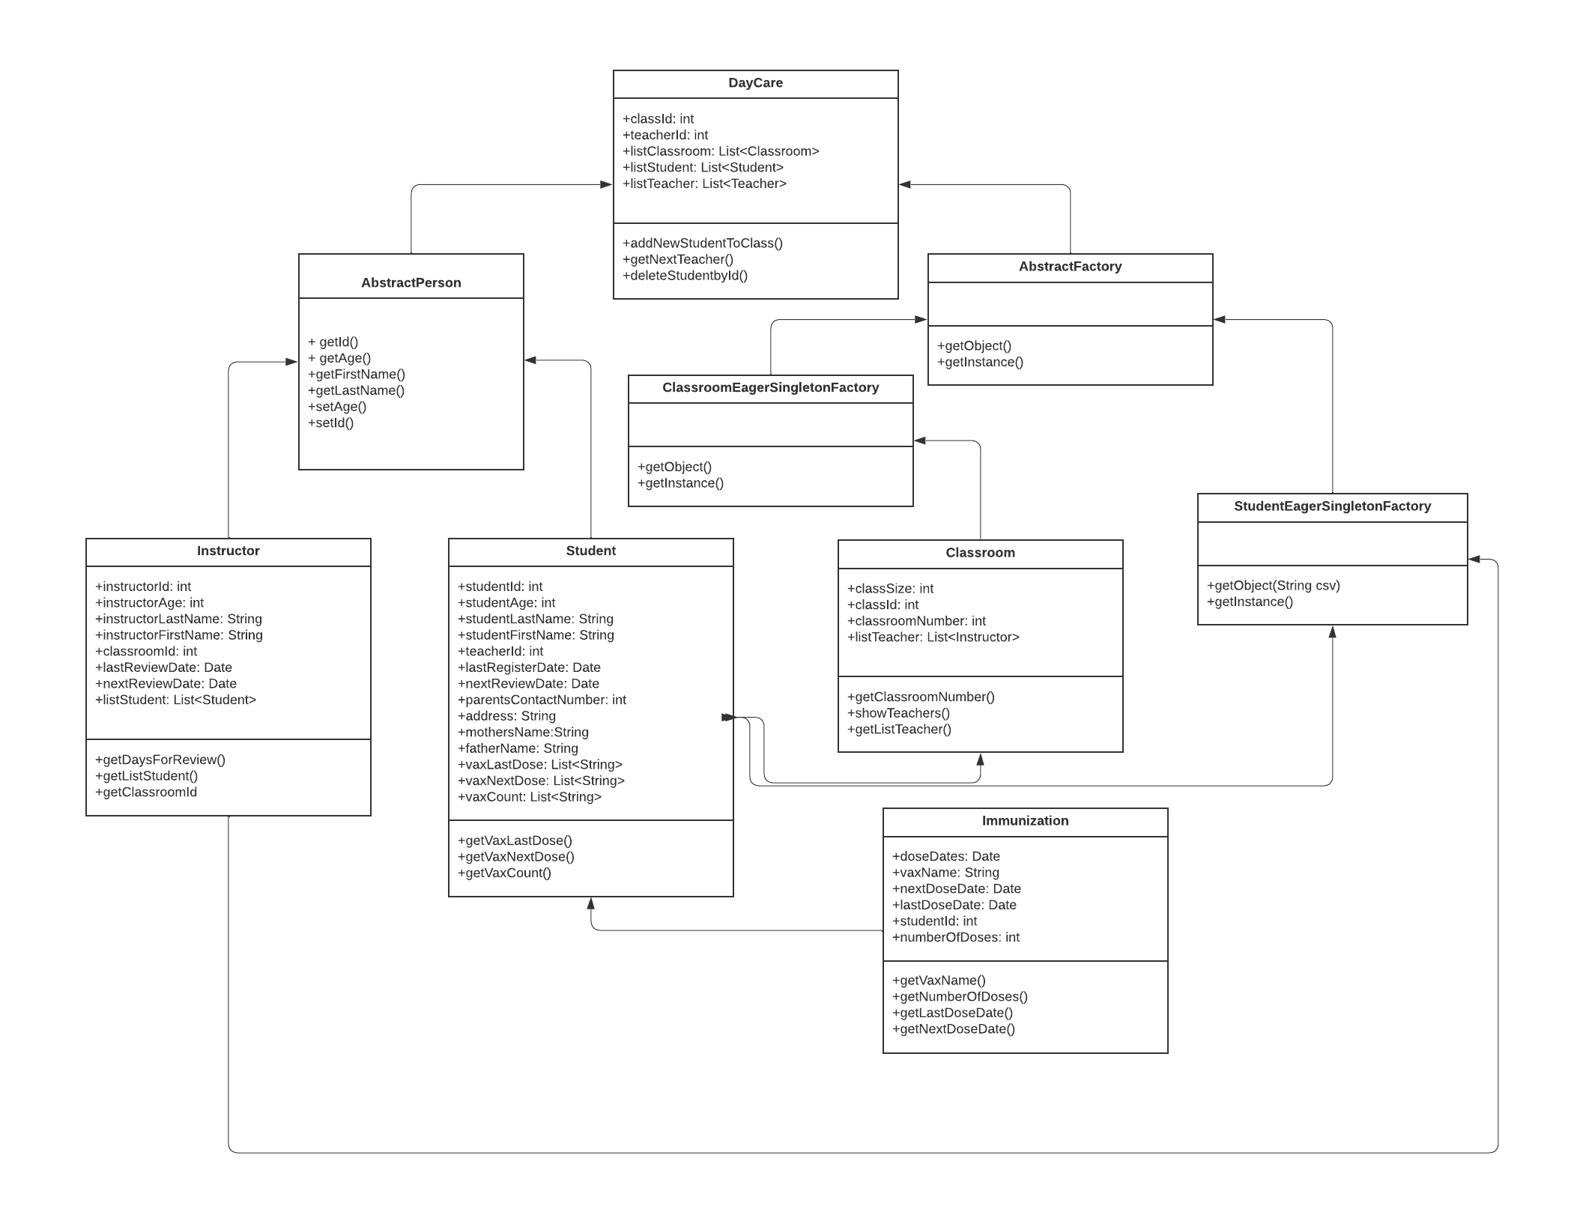
UML

Slide 10
CLASS KNOWLEDGE
Object-oriented design was implemented in applications.
SOLID design and the Simple Factory design pattern were used to enhance the performance of the program
01
02
03
Used Java Swing and GUI components
04
Usage of Lists and Map for better implementation

Slide 11
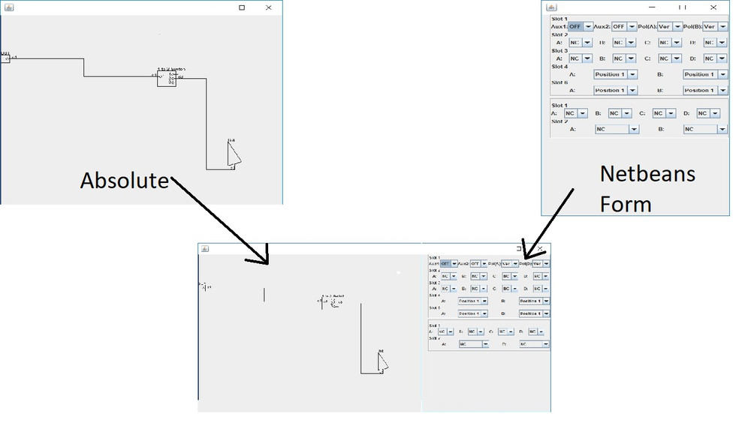
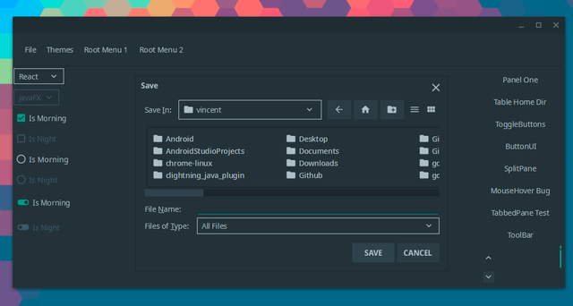
IMPORTED LIBRARIES
Material UI Swing
Absolute Layout

Slide 12

ADDITIONAL FEATURES AND FUTURE WORK
Integrate web applications such as Google and Zoom Classroom
Integrate immunization information from family insurance records for students
Implement Billing details and transactions with internet banking
Implement cloud backup database for various branches of Daycare

Slide 13
RATIO RULES
Age (months) | Group Size | Ratio (Student:Teacher) | Max Groups/Room
6-12 | 4 | 4:1 | 3
13-24 | 5 | 5:1 | 3
25-35 | 6 | 6:1 | 3
36-47 | 8 | 8:1 | 3
48-59 | 12 | 12:1 | 2
60 on up | 15 | 15:1 | 2

Slide 14
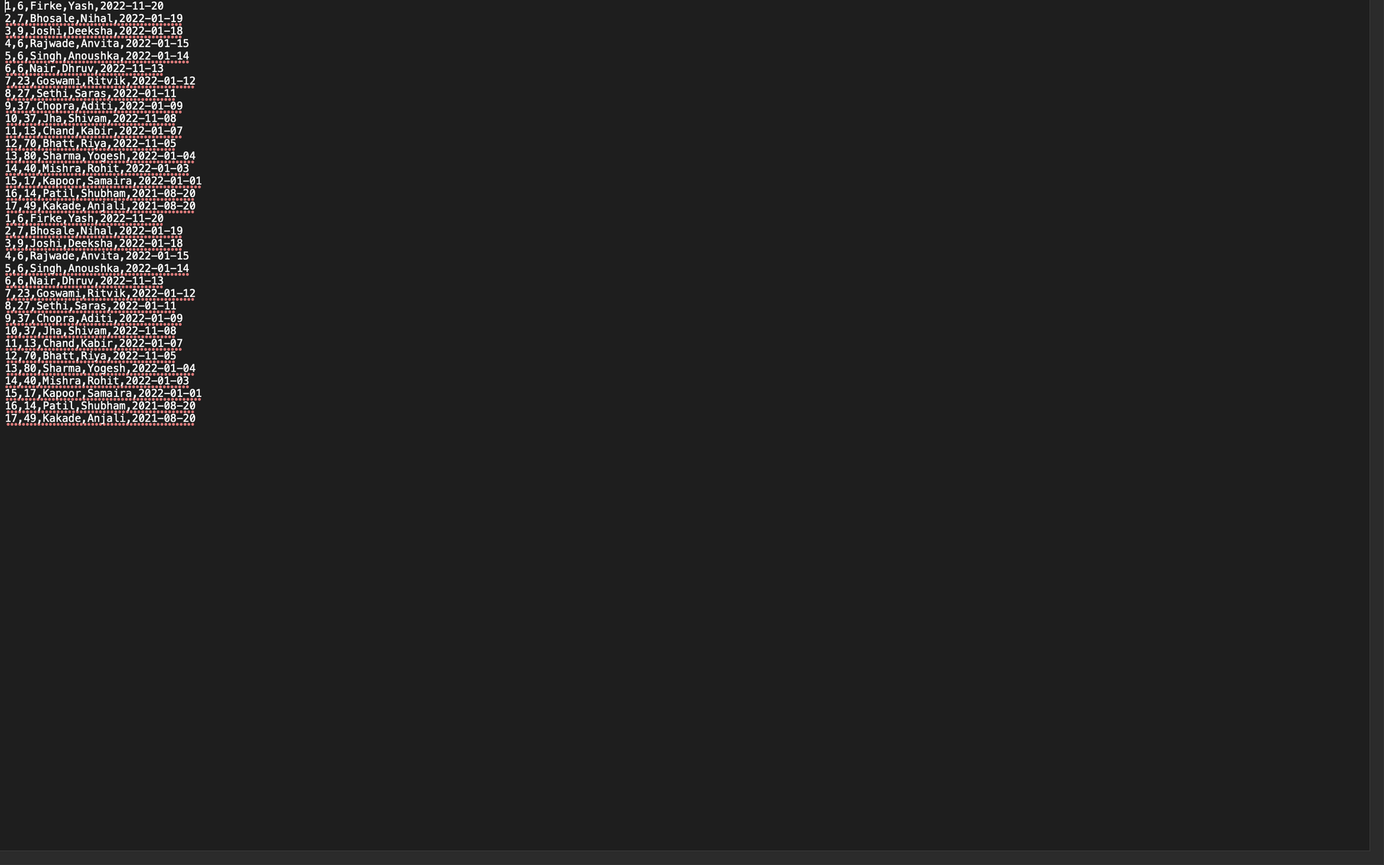
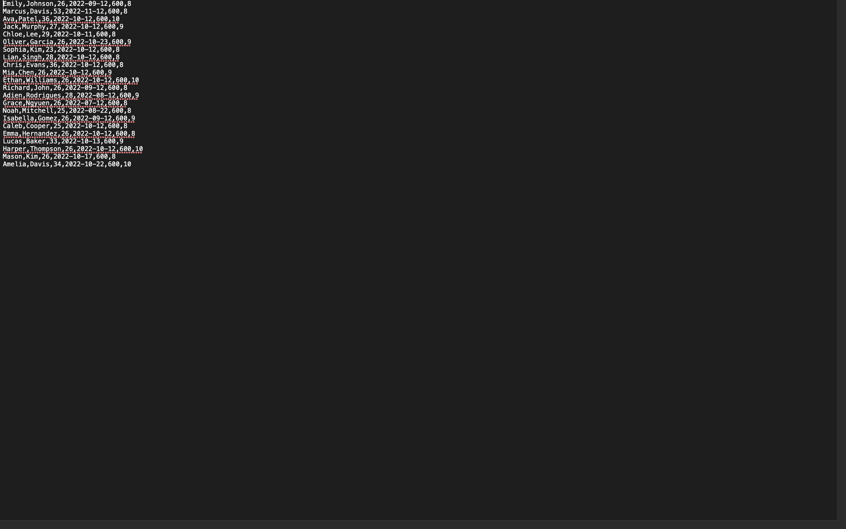
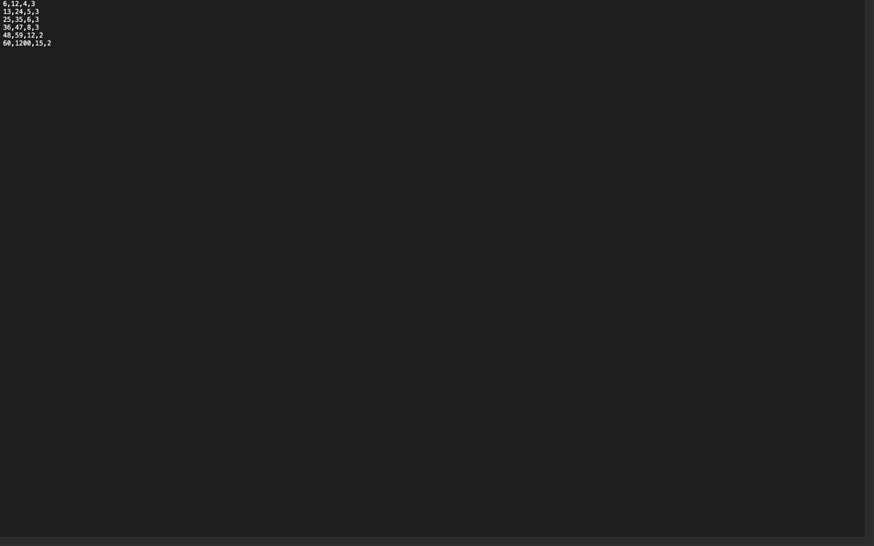
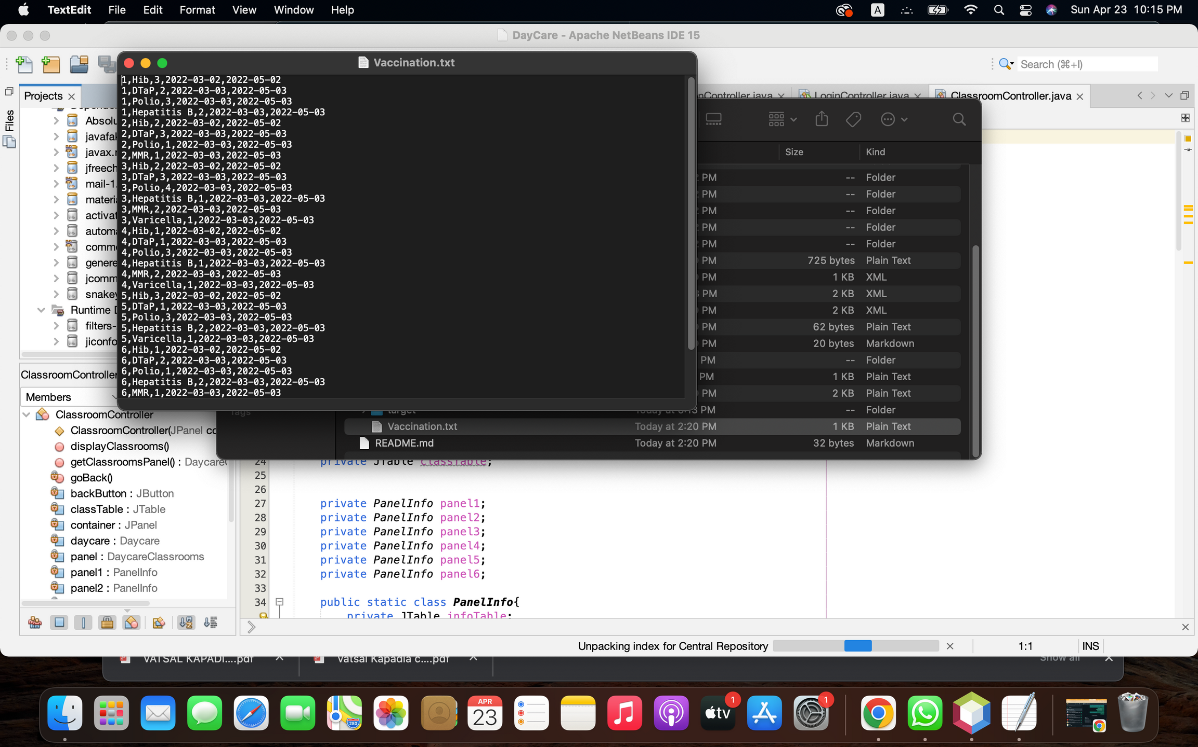
DATA FROM CSV
CSV 1: STUDENTS
CSV 2: TEACHERS
CSV 3: RATIO RULES
CSV 4: VACCINATION
Get Students Data from this csv
Gets Teachers Data from this CSV
Get Ratio rules from this csv
Get information from this csv

Slide 15
CONTRIBUTION
ANJALI & NETRA | Views + Swing UI
RAKESH & VATSAL | ModelsjjkkConfiguration + Data Creation
YASH & SHUBHAM | MfdvdvfbddModels + Controller

Slide 16

THANK YOU

